Slide 1
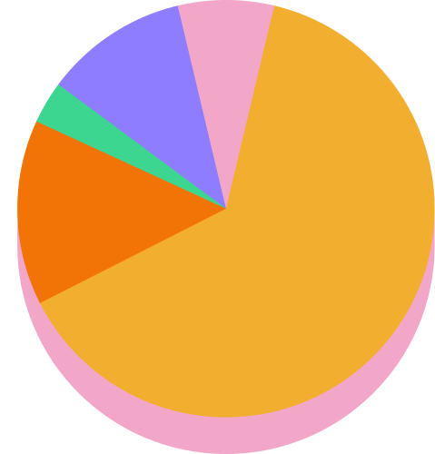
Presenting Insights
of
AtliQ Hardware

Slide 2

Company overview
Atliq Hardwares is one of the leading computer hardware producers in India and well expanded in other countries too.
Channels involved for Sales: Direct, Retailer, Distributor
Regions where Atliq is expanded: APAC, EU, NA, LATAM

Slide 3

objectives
Improve the quality and availability of insights to enable quick and smart data-informed decisions about Atliq Hardware

Slide 4
Technology used
MySQL

Slide 5

Databases overview
dim_customer,
dim_product,
fact_sales_monthly,
fact_gross_price,
fact_manufacturing_cost,
fact_pre_invoice_deductions

Slide 6
Project steps
Data Cleaning,
Data transformation,
Query writing to find insights

Slide 7
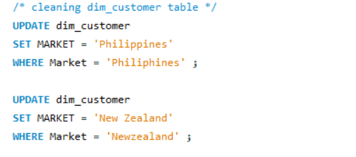
Data Cleaning
I have done basic data cleaning using DML commands like UPDATE and SET. This step involves correcting some minor mistakes in spelling of a few countries.

Slide 8
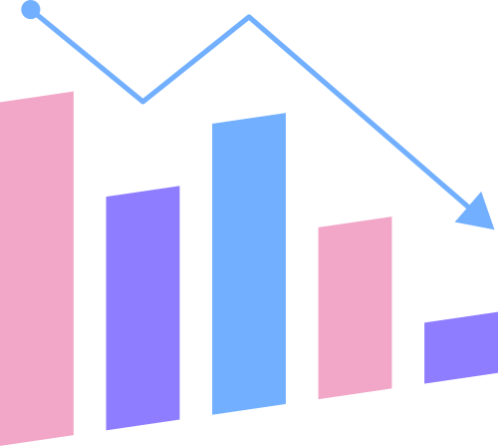
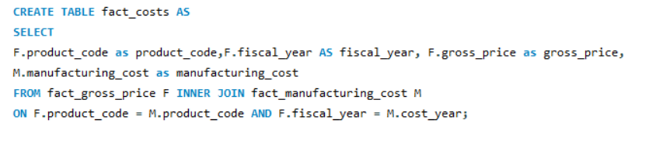
Data transformation
Taking gross_price and fact_manufacturing_cost under a new single table called fact_costs to avoid using multiple tables while writing queries.

Slide 9
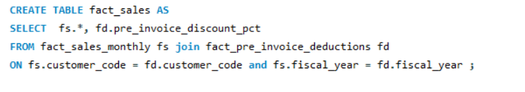
Data transformation
Creating a new table using the fields of fact_sales_monthly and fact_pre_invoice_deductions to keep the deductions and sales data under a single table keeping the provided database intact.

Slide 10
Answering the ad-hoc questions
and fetching insights

Slide 11

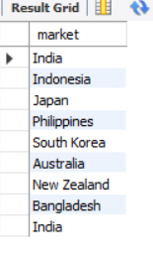
Q1. Provide the list of markets in which customer "Atliq Exclusive" operates its business in the APAC region.
Code:
Output:

Slide 12
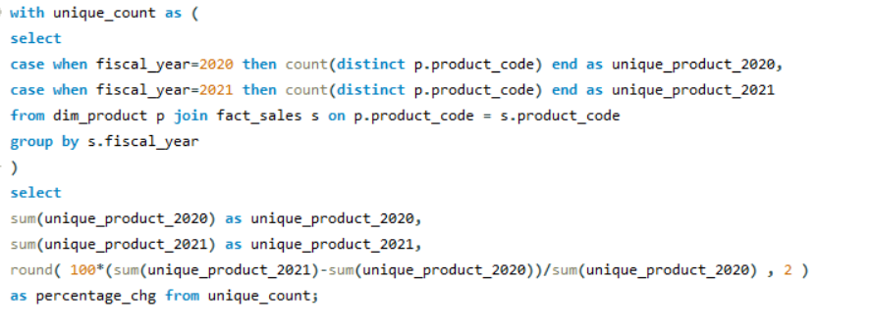

Q2. What is the percentage of unique product increase in 2021 vs. 2020?
The final output contains these fields, unique_products_2020 unique_products_2021 percentage_chg
Code:
Output:

Slide 13

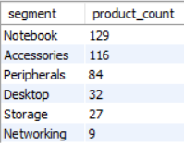
Q3. Provide a report with all the unique product counts
for each segment and sort them in descending order of product counts. The final output contains 2 fields, segment, product_count
Code:
Output:

Slide 14
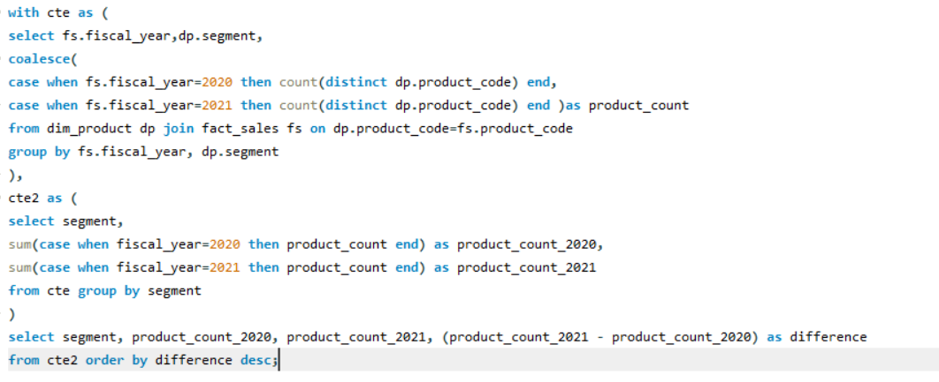
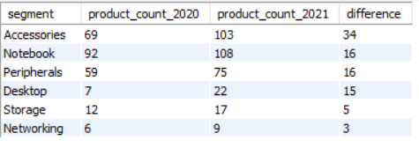
Q4. Follow-up: Which segment had the most increase in unique products in 2021 vs 2020? The final output contains these fields: segment, product_count_2020, product_count_2021, difference
Code:
Output:

Slide 15
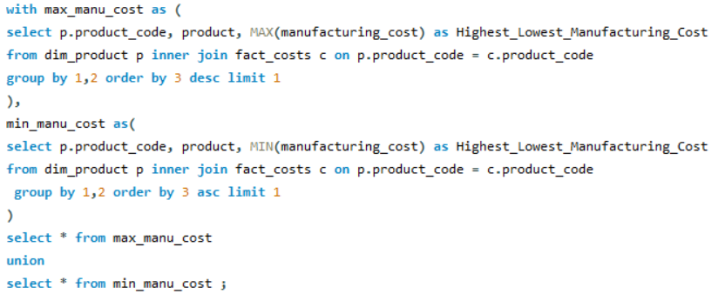

Q5. Get the products that have the highest and lowest manufacturing costs.
The final output should contain these fields: product_code, product, manufacturing_cost
Code:
Output:

Slide 16
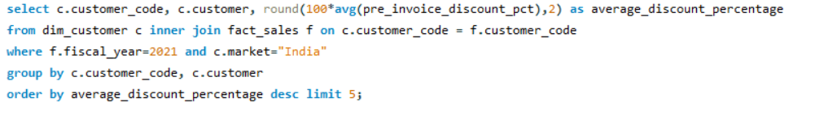
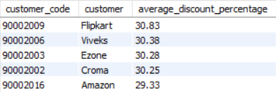
Q6. Generate a report which contains the top 5 customers who received an average high pre_invoice_discount_pct for the fiscal year 2021 and in the Indian market. The final output contains these fields: customer_code, customer, average_discount_percentage
Code:
Output:

Slide 17
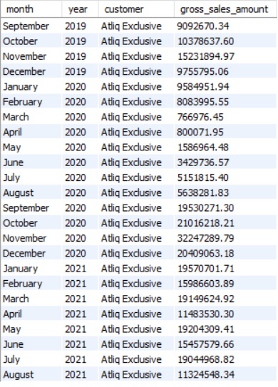
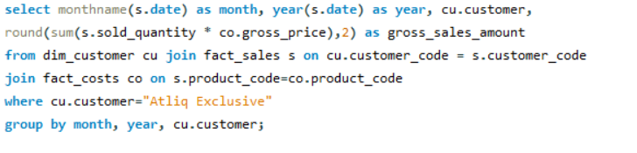
Q7. Get the complete report of the Gross sales amount for the customer “Atliq Exclusive” for each month . This analysis helps to get an idea of low and high-performing months and take strategic decisions. The final report contains these columns: Month, Year, Gross sales Amount
Output:
Code:

Slide 18

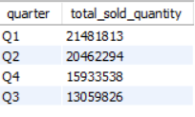

Q8. In which quarter of 2020, got the maximum total_sold_quantity?
The final output contains these fields sorted by the total_sold_quantity, Quarter total_sold_quantity
Code:
Output:

Slide 19
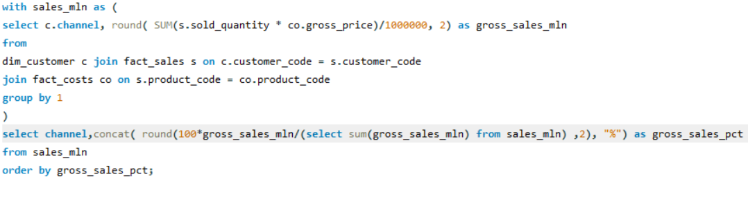

Q9. Which channel helped to bring more gross sales in the fiscal year 2021 and the percentage of contribution? The final output contains these fields: channel, gross_sales_mln percentage
Code:
Output:

Slide 20
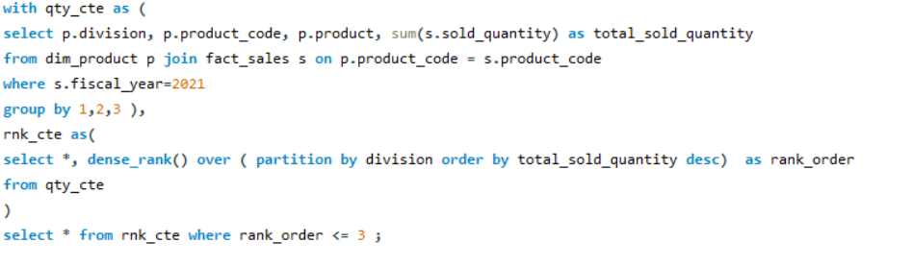
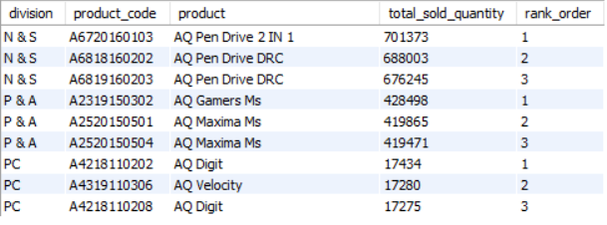
Q10. Get the Top 3 products in each division that have a high total_sold_quantity in the fiscal_year 2021? The final output contains these fields: division, product_code, product, total_sold_quantity, rank_order
Code:
Output:

Slide 21



